Slide 1

Les minutes MLOps
Workflow de travail d’un projet IA
Guillaume Chervet

Slide 2
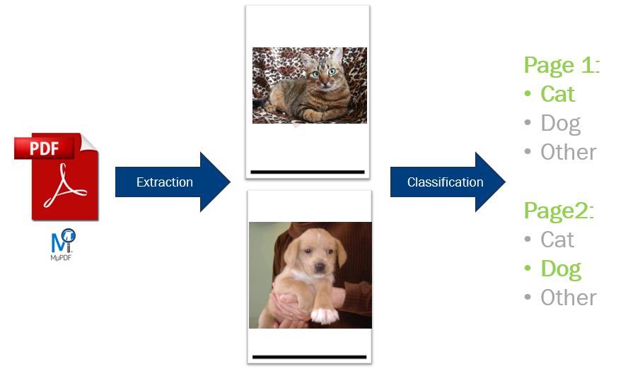
Les minutes MLOps – Guillaume Chervet - 2023

Slide 3
Artificial Intelligence
Machine Learning
Deep Learning
Supervised
Les minutes MLOps – Guillaume Chervet - 2023
Notes:
One of the subsets of artificial intelligence is machine learning and one of the subsets of machine learning is deep learning.

Slide 4
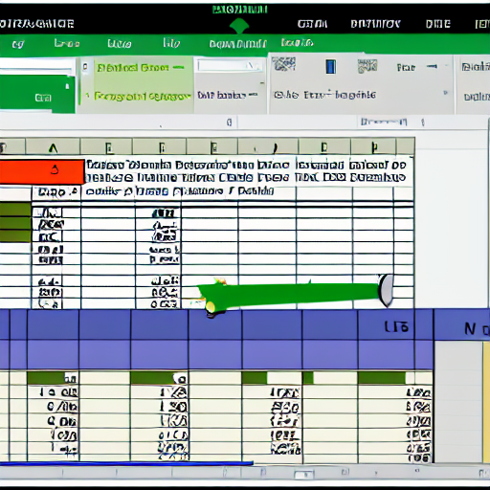
Structured data
"excel structured data"
Les minutes MLOps – Guillaume Chervet - 2023
Notes:
You will often hear about structured data usually being represented by an Excel file. In general, for this kind of problem where there is a limited number of inputs/outputs. We will use simple machine learning algorithms.

Slide 5



Unstructured data
"text from an old book on a table"
"camera outside on the beach"
"big music speaker"
Les minutes MLOps – Guillaume Chervet - 2023
Notes:
When we have data like: sounds, images, videos. The number of possible inputs/outputs is generally higher. Consequently, we will generally use Deep learning algorithms which use neural networks.

Slide 6

3 Paradigm shift
Notes:
slide / ! \ Attention changement important. Mettre un marqueur pour y revenir ensuite à la fin.

Slide 7
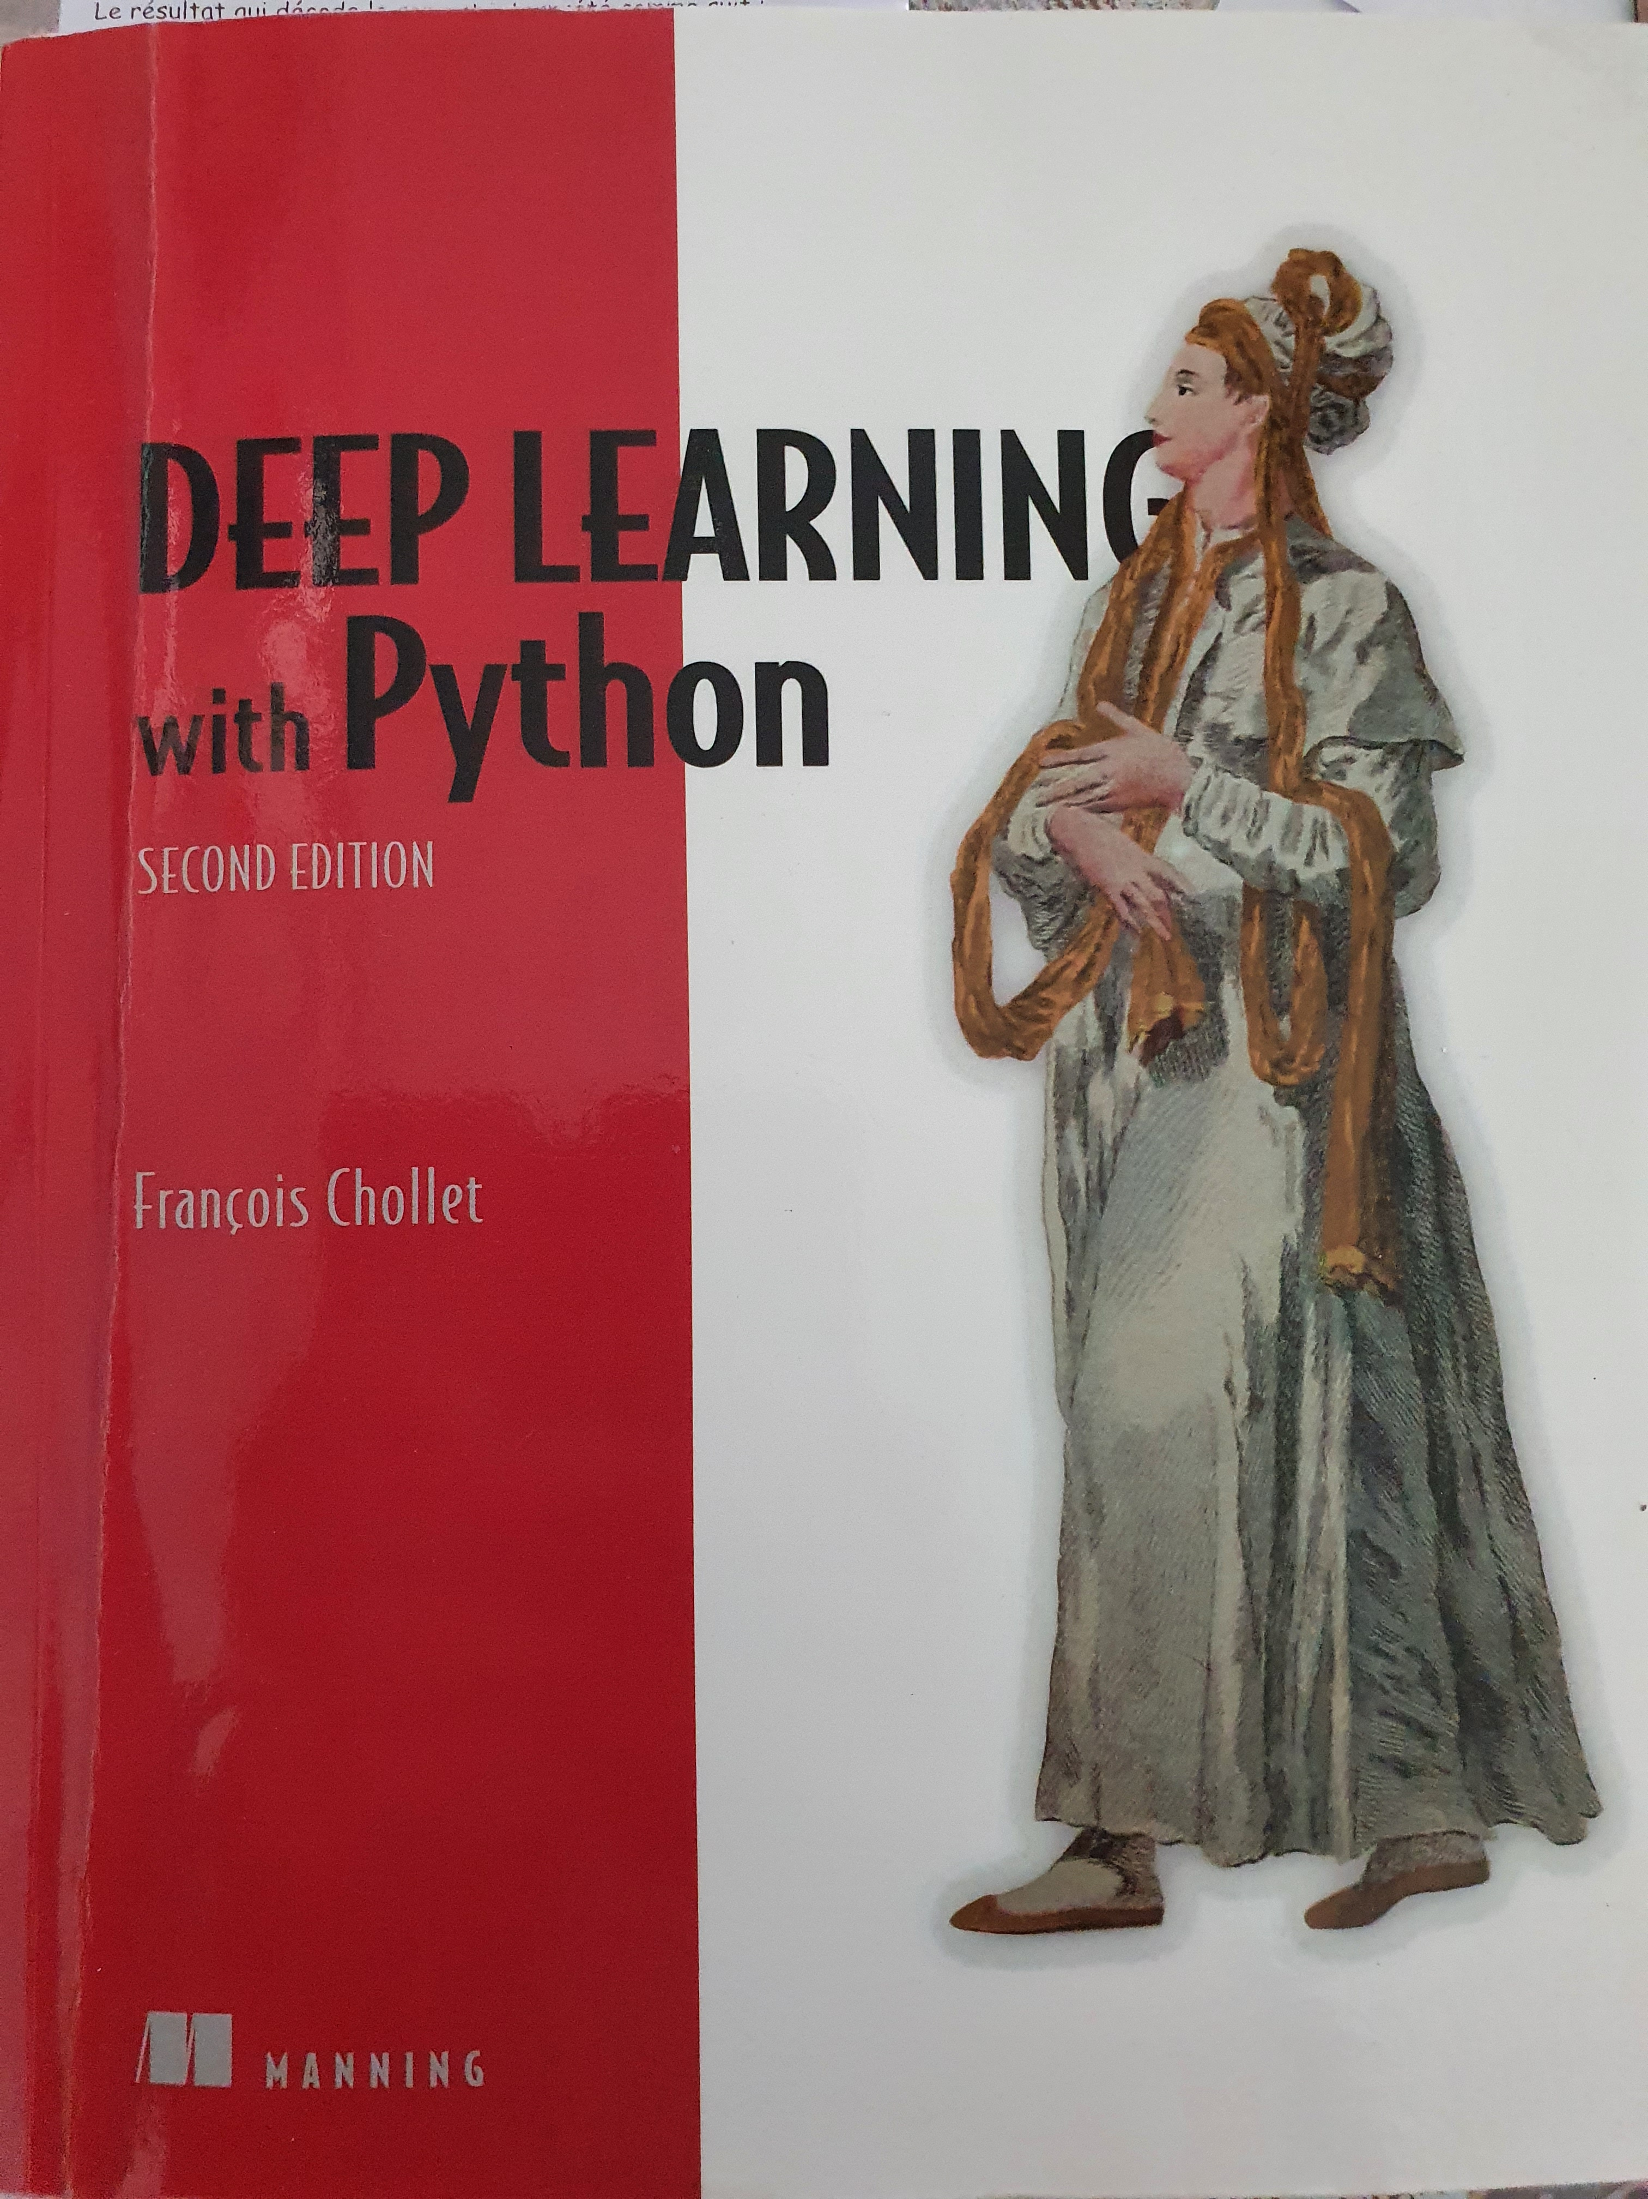
Deep Learning
1) Paradigm shift : Skills
Classical programming
Rules
Answers
Data
Source : François Chollet
Les minutes MLOps – Guillaume Chervet - 2023
Notes:
Changement de paradigme : compétences, projets, etc.

Slide 8
Deep Learning
1) Paradigm shift : Skills
Classical programming
Rules
Answers
Data
Machine Learning
Data
Rules
Answers
Source : François Chollet
Les minutes MLOps – Guillaume Chervet - 2023
Notes:
Changement de paradigme : compétences, projets, etc.

Slide 9
Deep Learning
1) Paradigm shift : Skills
Code
Data
Answer
Les minutes MLOps – Guillaume Chervet - 2023
Le MLOps est une aventure Humaine – Devoxx France 2023 – Guillaume Chervet

Slide 10
Deep Learning
1) Paradigm shift : Skills
Code
Data
Answer
AI model
Data
Answer
Les minutes MLOps – Guillaume Chervet - 2023
Le MLOps est une aventure Humaine – Devoxx France 2023 – Guillaume Chervet

Slide 11
Deep Learning
2) Paradigm shift : Data
Les minutes MLOps – Guillaume Chervet - 2023
Notes:
In the past, we used to talk about project as “model centric”, because we weren't sure we could make an appropriate AI.
Today most of the points on the AI ​​side: at least for our needs at AXA France, already have viable solutions. We know that we will be able to create an AI for our use cases.
On the other hand, the heart of the problem, really the thing that makes a project feasible or not: it is the data. If we have good data, of good quality, inputs and answers, a lot, that will really be game changer to the success of your project. The data is your treasure that will make the difference.

Slide 12

Ecotag
Deep Learning
3) Paradigm shift : It’s alive
Les minutes MLOps – Guillaume Chervet - 2023
Notes:
Changement : c’est vivant, comme qqun qui apprend, il doit continuer à s’adapter. Et donc on doit relivrer fréquemment pour s’adapter aux nouvelles data.

Slide 13
collect
Datasets
Les minutes MLOps – Guillaume Chervet - 2023
Notes:
So now, we are going to explain the workflow of a project. We want to build an email classification project.
The first thing to do is to retrieve data: inputs and answers. On this project, it was easy. We already had emails and answers because in production we already have humans who have been classifying the emails manually for several years. So, we already have the data and the answers, that's perfect to build up our first dataset.

Slide 14
collect
Datasets
use
Train AI
Les minutes MLOps – Guillaume Chervet - 2023
Notes:
Then, with this data, we will be able to iterate to create an AI and build an API that we can put into production.

Slide 15
Labelling
collect
Datasets
use
Train AI
Les minutes MLOps – Guillaume Chervet - 2023
Notes:
Then, with this data, we will be able to iterate to create an AI and build an API that we can put into production.

Slide 16
Labelling
collect
Datasets
use
Train AI
deploy
Production AI API
Les minutes MLOps – Guillaume Chervet - 2023

Slide 17
Labelling
collect
Datasets
use
Train AI
deploy
Production AI API
use
Consumer Production application
Les minutes MLOps – Guillaume Chervet - 2023
Notes:
After that, our application in production can be consumed by client applications.

Slide 18
Labelling
collect
Datasets
use
Train AI
deploy
Production AI API
use
Consumer Production application
collect
Feedback Loop
Les minutes MLOps – Guillaume Chervet - 2023
Notes:
In production, it is extremely important to set up what is called: the “feedback loop”. A virtuous circle. In the event of a classification error, the client applications must allow the error to be corrected manually. Over time, we will be able to build new dataset of a better quality and we will be able to improve our Artificial Intelligence.

Slide 19
Dataset of 20 000 files
Train a model
13 000 train
4 000 validation
3 000 test
Les minutes MLOps – Guillaume Chervet - 2023
Notes:
Before starting the demo. Imagine that we have 20,000 files available. We will use 17,000 files for training the model. Then we will keep 3000 files aside for validation, to test our model on data it has never seen. This validation DATASET will also be used to test our production environments.

Slide 20
Les minutes MLOps – Guillaume Chervet - 2023

Slide 21

"the god graal trophy"
Les minutes MLOps – Guillaume Chervet - 2023
Notes:
The Holy Grail for us; is to be able to re-train and re-deploy in production without any manual action

